Slide 1
Input and Interaction
B0729009_孫維嶺 B0729030_趙威竹B0729036_林品翰
B0729055_鍾佩宸 B0729058_林聖凱 B0829025_林宥任

Slide 2
This chapter
We now turn to the development of interactive graphics programs.
The discussion has three main parts
We introduce the variety of devices available for interaction.
Physical device
Logical device
We then consider client-server network and client-server graphics.
Even driven input for the graphics program
We develop a polygon modeling program that demonstrates many of these important features of interactive graphics programming
Notes:
將會提到可互動圖形程式(interactive graphics programs)的發展
分成3部分來討論
介紹各種可互動的裝置，例如:
Physical device
Logical device
然後是客戶端- Server端網路和客戶端- Server端圖形。
圖形程式中的事件驅動程式
最後會介紹一個多邊形建模程式，它演示了可互動式圖形程式的許多重要功能

Slide 3
Interaction (1)
One of the most important advances in computer technology was enabling users to interact with computer displays.
The user sees an image on the display. She reacts this image by means of an interactive device, such as a mouse. (the image changes in response to her input)
Interactivity is an important component of most applications. OpenGL (gl) does not support interaction directly.
Notes:
•電腦技術最重要的進步之一是使用的人能夠與電腦螢幕進行互動，用戶在螢幕上看到圖像。 她通過互動式設備（例如滑鼠）對這個圖像做出對應動作。 （圖像根據她的輸入而變化）
•

Slide 4
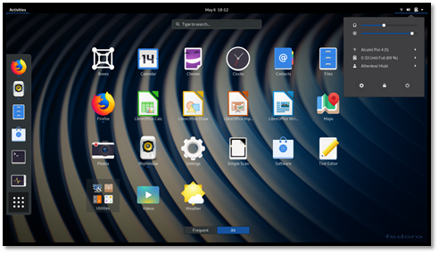

Interaction (2)
The GLUT toolkit provides the minimal functionality that is expected on virtually all systems.
We use the term window system.
Our use of the GLUT toolkit will enable us to avoid the complexities inherent in the interactions among the window system, the window manager, and the graphics system.
Notes:
•GLUT 工具包幾乎提供了所有系統都需要的最基礎功能，例如打開介面、使用鍵盤和滑鼠以及創建一個彈出式的選項菜單。
•
•我們使用術語窗口系統包括了例如 X 窗口系統之類的系統所提供的整體環境。
•
•我們使用 GLUT 工具包可以讓我們避免在窗口系統、窗口管理器和圖形系統之間互動時太過複雜。
•

Slide 5
Interaction (3)
We start by describing several interactive devices and the variety of ways that we can interact with them.
Then we put these devices in the setting of a client-sever network and introduce an API for minimal interaction.
Finally, we generate a simple programs.
Notes:
我們首先描述幾種互動式設備以及我們可以與它們互動的各種方式。
並引入一個 API 以實現最低程度的互動。
最後會demo一個簡單的程式。

Slide 6
Input Devices (1)
We can think about input devices in two distinct ways.
Physical devices as keyboard and mouse and to discuss how they work.
Logical devices, what they do from the perspective of the application program. A logical device is characterized by its high-level interface with the application.
int x;
scanf(&x);
printf(“%d”,x);
Rather scanf and printf are logical functions that are defined how they handle input or output character strings from the perspective of the C program.
Notes:
我們可以從兩種不同的方式來考慮輸入設備。
物理設備例如鍵盤和滑鼠
邏輯設備，從應用程序的角度來看它們做什麼例如interface

Slide 7
Input Devices (2)
When we output a string of characters using printf or cout, the physical device on which the output appears could be a printer, a terminal, or a disk file.
In computer graphics, the use of logical devices is somewhat more complex.
Physical Input Devices
Pointing device allows the user to indicate a position on a display and almost always incorporates one or more buttons to allow the user to send signals or interrupts to the computer.
Notes:
輸出的物理設備可能是影印機、terminal或磁盤文件。
Pointing device例如滑鼠電腦繪圖觸控筆
讓用戶在螢幕上指示位置

Slide 8
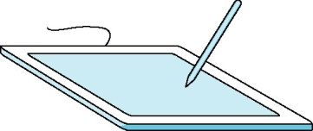
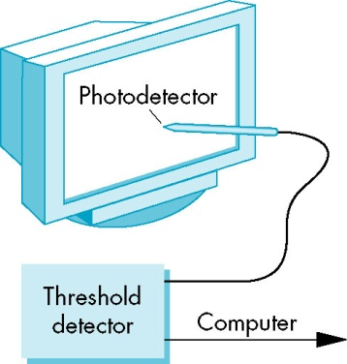

Input Devices (3)
A mouse moves across a surface, the integral of the velocities yield x, y value that can be converted to indicate the position for a cursor on the screen.
These devices are relative-positioning devices because changes in the position of the ball yield a position in the user program.
Data tablets provides absolute positioning. A typical data tablets has rows and columns of wires embedded under its surface.
Notes:
鼠標在螢幕表面上移動時的速度積分可以產生 x、y 值，這些值可以轉換為指示標在營幕上的位置。

Slide 9
Input Devices (4)
Logical Devices
We can now return to looking at input from inside the application program-that is, from the logical point of view.
Two major characteristics
The measurements that device returns to the user program
The time when the device returns those measurements.
Some earlier APIs defined six classes of logical devices. OpenGL does not take this approach.
Notes:
回到從應用程序面來看輸入
兩大特點
設備return給使用者程式run完之後測量的值
設備還會再return這些測量值的時間。
一些早期的 API 定義了總共六類邏輯設備。
但OpenGL 不採用這種方法。

Slide 10
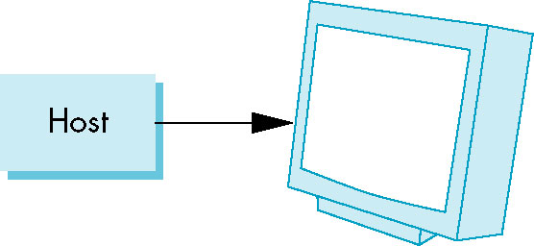
Display Lists (1)
Display lists illustrate how we can use clients and servers on a network to improve interactive graphics performance.
Display lists have their origins in the early days of computer graphics.
At the time (1960), computers were slow and expensive, so the cost of keeping even a simple display refreshed was prohibitive for all but a few applications.
The solution to this problem was to build a special-purpose computer, called display processor.

Slide 11
Display Lists (2)
The user program was processed in the host computer, resulting in a compiled list of instructions that was then sent to the display processor, where the instructions were stored in a display memory as a display file, or display list.
Today, the display processor of old has become a graphics server, and the application program on the host computer has become a client.
The major bottleneck is no longer the rate at which we have to refresh the display, but rather the amount of traffic that passes between the client and server.
In addition, the use of special-purpose hardware now characterizes high-end systems.

Slide 12
Display Lists (3)
We can send graphics entities to a display in one of two ways.
First, we can send the complete description of the objects to the graphics server.
The typical geometric primitives, this transfer entails sending vertices, attributes, and primitive types.
In immediate mode, primitive is sent to the server for possible display and no memory of it is retained in the system.
The redisplay the primitive after a clearing of the screen, or in a new position after an interaction, the program must respecify the primitive an then must resend the information through the display process.

Slide 13
Display Lists (4)
The second method is called retained mode graphics.
The display list is stored in the server and redisplay by a simple function call issued from the client to the server.
This mode allows much of the overhead in executing commands to be done once and have the results stored in the display list on the graphics server.
A good numerical-processing computer that execute the client program and a special-purpose graphics computer for the server.
In modern workstations that use commodity graphics cards in which the GPU carries out most rendering commands, there may not be a performance advantage in using display lists.

Slide 14
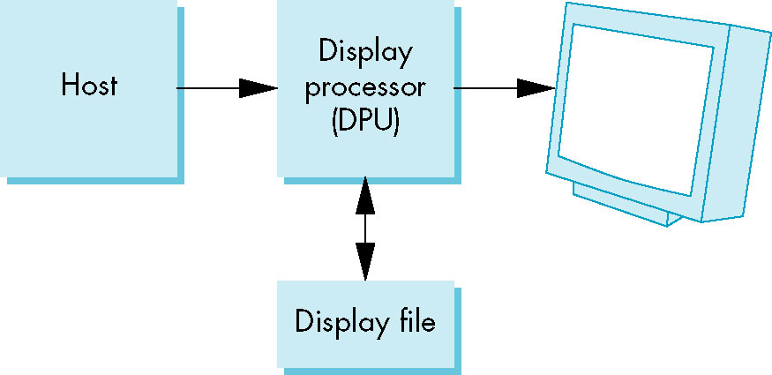
Display Lists (5)
Definition and Execution of Display Lists
There must be a mechanism to define and manipulate them
OpenGL has a small set of functions to manipulate display lists and places only a few restrictions on display list contents.
Display lists are defined similarly to geometric primitives. There is a glNewList at the beginning and a glEndList at the end.

Slide 15
Display Lists (6)
Each display list must have a unique identifier- an integer that is usually macro defined in the C program by means of a #define directive to an appropriate name for the object in the list.
#define BOX 1
glNewList (BOX, GL_COMPILE);
glBegin(GL_POLYGON)
glColor3f(1.0, 0.0, 0.0);
glVertex2f(-1.0, -1.0);
glVertex2f(1.0, 1.0);
glVertex2f(1.0, 1.0);
glVertex2f(-1.0, 1.0);
glEnd();
glEndList();

Slide 16
Display Lists (7)
The flag GL_COMPILE tells the system to send the list to the server but not to display its contents. An immediate display by using the GL_COMPILE_AND_EXECUTE flag.
Each time that we wish to draw the box on the server, we execute the function as follows:
glCallList (BOX);
The current state determines which transformations are applied to the primitives in the display list. We change the model-view and projection matrices between executions of the display list, the box will appear in different places or will no longer appear.

Slide 17
Display Lists (8)
glMatrixMode(GL_PROJECTION);
for (i=1;i<5;i++)
{
glLoadIdentity();
glOrtho2D(-2.0*i, 2.0*i , -2.0*i, 2.0*i);
glCallList(BOX);
}
The glCallList is executed, the box is redrawn.

Slide 18
Display Lists (9)
The easiest safeguard is to use the matrix and attribute stacks provided by OpenGL. We can save the present values of attributes and matrices by placing or pushing them on the top of the appropriate stack. We can recover then later by removing or popping them from the stack.
glPushAttrib(GL_ALL_ATTRIB_BIT);
glPushMatrix();
glPopAttrib();
glPopMatrix();

Slide 19
Display Lists (10)
A few additional functions are available that make it easier to work with display lists.
We can create multiple lists with consecutive identifiers more easily if we use the function glGenLists(number), which return the first integer (or base) if number consecutive integers that are unused labels.
The function glCallLists allows us to execute multiple display lists with a single function call.
Text and Display Lists
Suppose that we use a raster font in which each character is stored as an 8×13 pattern of bits. It takes 13 bytes to store each character.

Slide 20
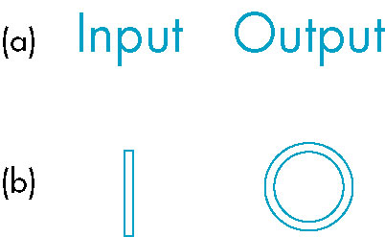
Display Lists (11)
If we want to display a string by the most straightforward method, we can send each character to the server each time that we want it displayed.
This transfer requires the movement of at least 13 bytes per character.
If we define a stroke font using only line segment, each character can require a different number of lines.
A more efficient strategy is to define the front
once, using a display list for each character, and
then to store the font on the server using these
display lists.

Slide 21
Display Lists (12)
The basics of defining and displaying a character string (1 byte per character) using a stroke font and display lists provide a simple but important example of the use of display lists in OpenGL.
First, we define a function OurFont (char c)
Void OurFont (char c)
{ switch (c)
{case ‘a’:
…
break;
case ‘A’:
…
break;
}
}

Slide 22
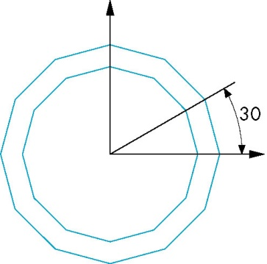
Display Lists (13)
Within each case, we have to be careful about the spacing; each character in the sting must be displayed to the right of the previous character.
We can use the translate function to get the desired spacing or shifting the vertex positions. Other characters can be defined in a similar manner.
case’o’:
glTranslatef(0.5, 0.5, 0.0);
glBegin(GL_QUAD_STRIP);
for(i=0;i<12;i++)
{ angle=3.14159/6.0*I;
glVertex2f(0.4*cos(angle)+0.5;0.4*sin(angle)+0.5);
glVertex2f(0.5*cos(angle)+0.5;0.5*sin(angle)+0.5);
}
glEnd();
break;}

Slide 23
Display Lists (14)
Suppose that we want to generate 256-character set. The required code, using the OutFont function is as follows:
base=glGenLists(256);
for(i=0;i<256;i++)
{
glNewList(base+i, GL_COMPILE);
OurFont(i);
glEndList();
}
When we wish to use these display lists to draw individual characters, rather than offsetting the identifier of the display lists by base each time, we can set an offset as follows:
glListBase(base);

Slide 24
Display Lists (15)
Our drawing of a string is accomplished in the server by the function call
char *text_string;
glCallLists((GLint) strlen(text_string), GL_BYTE, text_string);
Fonts in GLUT
In general, we prefer to use an existing font rather than to define our own. GLUT provides a few raster and stroke fonts.
We can access a single character from a monotype. GLUT_STROKE_MONO_ROMAN provides proportional spaced characters
glutStrokeCharacter(GLUT_STROKE_MONO_ROMAN, int character);

Slide 25
Display Lists (16)
In addition, each invocation of glutStrokeCharacter includes a translation to the bottom right of the character’s box, to prepare for the next character.
Raster and bitmap character are produced in a similar manner,
glutBitmapCharacter(GLUT_BITMAP_8_By_13, int character);
Positioning of bitmap characters is considerably simpler than the positioning of stroke characters is because bitmap characters are drawn directly in the frame buffer and are not subject to geometric transformation.
If characters have different widths, we can use the glutBitmapWidth(font, char) function to return the width of a particular character.

Slide 26
Display Lists and Modeling
Because display lists can call other display lists, they are powerful tools for building hierarchical models that can incorporate relationships among parts of a model.
#define EYE 1 #define FACE 2
glNewList(EYE); glNewList(FACE);
/*eye code*/ /*draw the outline*/
glEndList(); glTranslatef(…)
glCallList(EYE);
glTranslatef(…)
glCallList(EYE);
glTranslatef(…)
glCallList(NOSE);
glEndList();

Slide 27

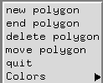
Menus (1)
We could use the graphics primitives and the mouse callbacks to construct various graphics input devices. (as slidebar) However, much of the code would be tedious to develop.
GLUT provides one additional feature, pop-up menus, that we can use with the mouse to create sophisticated interactive applications.
Using menus involves taking a few simple steps.
We must define the actions corresponding to each entry in the menu.
We must link the menu to a particular mouse button.
Finally, we must register a callback function for each menu.
Notes:
我們可以使用圖形基元和鼠標回調來構建各種圖形輸入設備。 （例如滑動條）
但這樣做起來很單調乏味
所以提供了一項附加功能，即彈出菜單選項，我們可以通過鼠標使用它來創建複雜的互動式應用程序。(例如右側)

Slide 28
Menus (2)
//創建一個Menu
glutCreateMenu(demo_menu);
glutAddMenuEntry(“quit”,1);
glutAddMenuEntry(“increase square size”, 2);
glutAddMenuEntry(“decrease square size”, 3);
//右鍵叫出menu
glutAttachMenu(GLUT_RIGHT_BUTTON);
The function glutCreateMenu registers the callback function demo_ menu.
Notes:
例如這邊有幾個操控圖形的選項

Slide 29
Menus (3)
void demo_menu(int id)
{
switch (id)
{
case 1: exit(0);
break;
case 2: size = 2*size;
break;
case 3: if(size >1) size= size/2;
break;
}
glutPostRedisplay();
}
The call to glutPostRedisplay requests a redraw through the glutDisplayFunc callback, so that the screen is drawn again without the menu.
Notes:
glutPostRedisplay 標記當前視窗需要重新繪製。 通過glutMainLoop下一次循環時，視窗顯示將被回調以重新顯示視窗的正常面板。多次調用glutPostRedisplay，在下一個顯示回調只產生單一的重新顯示回調。

Slide 30
Picking (1)
Picking is a logical input operation that allows the user to identify an object on the display.
Although the action f picking users the pointing device, the information that the users wants returned to the application program is not a position.
A pick device is considerably more difficult to implement on a modern system than is a locator.
One reason for the difficulty of picking in modern systems is the forward nature of the rendering pipeline.
Notes:
挑選(1)
挑選是一種邏輯輸入操作，允許用戶識別顯示器上的對象。
雖然選擇用戶指向設備的動作，但是用戶想要返回給應用程序的信息不是位置。
在現代系統上，拾取裝置比定位器更難實現。
在現代系統中選擇困難的原因之一是渲染管道的前向性。

Slide 31
Picking (2)
There are least three ways to deal with this difficulty.
One process, known as selection, involves adjusting the clipping region and viewport such that we can keep track of which primitives in a small clipping region are rendered into a region near the cursor.
These primitives go into a hit list that can be examined later by the user program.
OpenGL supports this approach.
A simple approach is to use (axis-aligned) bounding boxes or extents for objects of interest.
For a two-dimensional applications, it is relatively easy to determine the rectangle in screen coordinates that corresponds to a rectangle point in object or world coordinates.
If the applications program maintains a simple data structure to relate objects and bounding boxes, approximate picking can be done within the application program.
Notes:
挑選(2)
至少有三種方法可以解決這個困難。
一個稱為選擇的過程涉及調整剪輯區域和視口，以便我們可以跟踪將小剪輯區域中的哪些圖元渲染到光標附近的區域中。
這些原語進入一個命中列表，稍後可由用戶程序檢查。
OpenGL 支持這種方法。
一種簡單的方法是對感興趣的對象使用（軸對齊）邊界框或範圍。
對於二維應用程序，確定屏幕坐標中的矩形與對像或世界坐標中的矩形點相對應是相對容易的。
如果應用程序維護一個簡單的數據結構來關聯對象和邊界框，則可以在應用程序內進行近似拾取。

Slide 32
Picking (3)
Another simple approach involves using the back buffer and an extra rendering. (double buffering)
Picking and Selection Mode
The difficult problem in implementing packing within the OpenGL pipeline is that we cannot go backward directly from the position of the mouse to primitives that were rendered close to that point on the screen.
OpenGL provides a somewhat complex process using a rendering mode called selection mode to do picking at the cost of an extra rendering each time that we do a pick.
A number of steps and functions are required to do picking using selection mode.
Notes:
挑選(3)
另一種簡單的方法涉及使用後台緩衝區和額外的渲染。 （雙緩衝）
揀選模式
在 OpenGL 管道中實現打包的困難問題是我們不能直接從鼠標的位置返回到屏幕上接近該點渲染的圖元。
OpenGL 提供了一個有點複雜的過程，它使用一種稱為選擇模式的渲染模式來進行拾取，但每次我們進行拾取時都會以額外渲染為代價。
使用選擇模式進行拾取需要許多步驟和功能。

Slide 33
Picking (4)
The function glRenderMode lets us select one of three modes:
normal rendering to the color buffer (GL_RENDER)
selection mode (GL_SELECT)
feedback mode (GL_FEEDBACK). Feedback mode can be used to obtain a list of the primitives that were rendered.
The return value from glRenderMode can be used to determine the number of primitives that were in the clipping volume.
When we enter selection mode and render a scene, each primitive within the clipping volume generates a message called a hit that is stored in a buffer called the name stack.
The information that we produce is called the hit list and can be examined after the rendering to obtain the information needed for picking.
Notes:
挑選(4)
函數 glRenderMode 允許我們選擇三種模式之一：
正常渲染到顏色緩衝區 (GL_RENDER)
選擇模式 (GL_SELECT)
反饋模式 (GL_FEEDBACK)。反饋模式可用於獲取已渲染圖元的列表。
glRenderMode 的返回值可用於確定剪輯體積中的圖元數量。
當我們進入選擇模式並渲染場景時，剪輯體積內的每個圖元都會生成一條稱為命中的消息，該消息存儲在名為名稱堆棧的緩衝區中。
我們生成的信息稱為命中列表，可以在渲染後進行檢查以獲得揀選所需的信息。

Slide 34
Picking (5)
void glSelectBuffer(GLsizei n, GLunint *buff)
Specifies the array buff of size n in which to place selection data.
void glInitNames()
This function initializes the name stack.
void glPushName(Gluint name)
This function pushes name on the name stack.
void glPopName()
This function pops the top name from the name stack.
Notes:
挑選(5)
void glSelectBuffer(GLsizei n, GLunint *buff)
指定大小為 n 的數組 buff，用於放置選擇數據。
void glInitNames()
此函數初始化名稱堆棧。
void glPushName(Gluint name)
此函數將名稱壓入名稱堆棧。
void glPopName()
This function pops the top name from the name stack.

Slide 35
Picking (6)
void glLoadName(Gluint name)
This function replaces the top of the name stack with name.
In general, each object that we wish to identify is a set of primitives to which we assign the same integer name.
We cannot load a name onto an empty stack, so we usually enter an unused name onto the stack when we initialize it.
glInitNames();
glPushName(0);
We typically use the mouse callback to enter selection mode an leave selection mode before the end of the mouse callback.
Notes:
挑選(6)
void glLoadName(Gluint name)
此函數用名稱替換名稱堆棧的頂部。
通常，我們希望識別的每個對像都是一組基元，我們為其分配相同的整數名稱。
我們無法將名稱加載到空堆棧中，因此我們通常在初始化堆棧時將未使用的名稱輸入到堆棧中。
glInitNames();
glPushName(0);
我們通常使用鼠標回調在鼠標回調結束之前進入選擇模式並離開選擇模式。

Slide 36
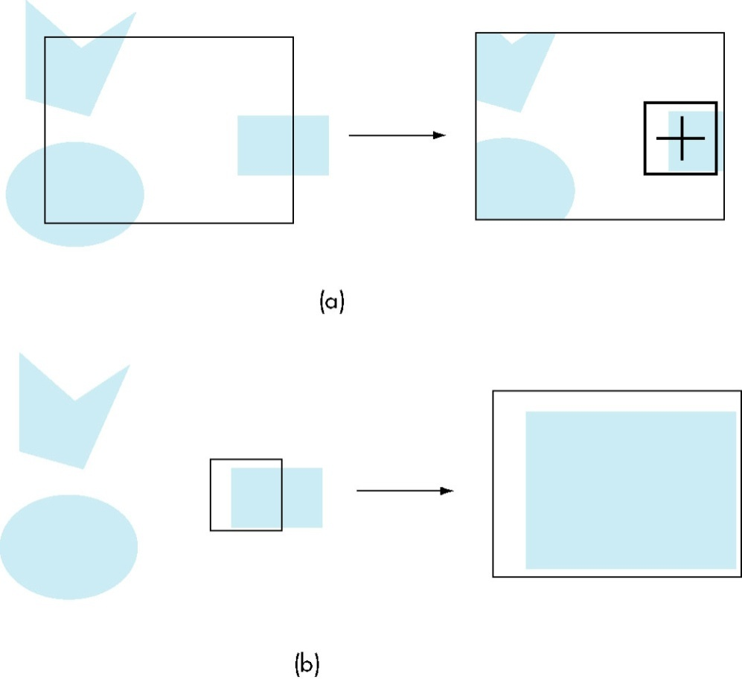
Picking (7)
When we return to render mode, glRenderMode returns the number of hits that have been processed. We then examine the hit list.
We can set the clipping volume in two ways.
We can simply define a view volume
through gluOrtho2D.
We would probably first want to save
the present clipping volume with a
glPushMatrix.
Suppose that we want all of objects
that render into a small user define
rectangle centered at the cursor.
Notes:
挑選(7)
當我們返回渲染模式時，glRenderMode 返回已處理的命中數。然後我們檢查命中列表。
我們可以通過兩種方式設置剪輯音量。
我們可以簡單地定義一個視圖體積 通過 gluOrtho2D。
我們可能首先想保存 當前的剪裁量 glPush 矩陣。
假設我們想要所有的對象 渲染成一個小的用戶定義 以光標為中心的矩形。

Slide 37
Picking (8)
We can let OpenGL do this calculation for us through the GLU function gluPickMatrix, which is applied before glOrtho2D when we are in selection mode.
gluPickMatrix (x, y, w, h, *vp)
This function creates a projection matrix for picking that restricts drawing to a w×h area centered at (x, y) in window coordinates within the viewport vp.
Assume that we have set up the viewing conditions for normal rendering during initialization or in the reshape callback, the mouse and display callbacks are of the following form:
Notes:
挑選(8)
我們可以讓 OpenGL 通過 GLU 函數 gluPickMatrix 為我們做這個計算，當我們處於選擇模式時，它在 glOrtho2D 之前應用。
gluPickMatrix (x, y, w, h, *vp)
此函數創建一個用於拾取的投影矩陣，該矩陣將繪圖限制在以 (x, y) 為中心的 w×h 區域，在視口 vp 內的窗口坐標中。
假設我們在初始化時或者reshape回調中設置了正常渲染的查看條件，鼠標和顯示回調的形式如下：

Slide 38
Picking (9)
We can use glPushName to allow multiple names on the stack for a given hit.
For an object with multiple parts, all the parts that were close to the cursor have their names placed in the same stack.
We can use the processHits to print the information for the example.
Notes:
我們可以使用 glPushName 允許堆棧上有多個名稱用於給定的命中。
對於具有多個部件的對象，靠近光標的所有部件的名稱都放在同一個堆棧中。
我們可以使用 processHits 打印示例的信息。

Slide 39
A Simple CAD Program (1)
Although these uses of CAD are wide-ranging, the graphics and interaction tend to have much in common, including the following:
The use of multiple windows and viewports to display a variety of information.
The ability to create, delete, and save user-defined objects.
Multiple modes of operation employing menus, keyboard, and mouse.
OpenGL’s primary concern is rendering geometry.
Notes:
儘管CAD的使用範圍很廣，但圖形和交互式有很多共同點，包含以下幾點:
1.使用多個視窗和網頁可視區域來顯示多種資訊
2.可以創建，刪除，和儲存user定義的物件
3.採用菜單，鍵盤，和滑鼠的多種操作模式
OpenGL 主要關注渲染幾何圖形

Slide 40
A Simple CAD Program (2)
We will develop a polygon-modeling application, Although it will be somewhat simple, it will illustrate many of the key features of a CAD application.
Creation of polygons
Deletion of polygons
Selection and movement of polygons
These requirements imply that we need a data structure to support these operations and to provide storage of polygons so that they can be redisplayed.
Notes:
我們將開發一個多邊形建模應用程式，儘管他很簡單，但他將說明CAD應用的許多關鍵功能
1.創建多邊形
2.刪除多邊形
3.挑選和移動多邊形
這些需求意昧著我們需要一個data structure去支持這些操作和提供多邊形儲存，以便他重新展示

Slide 41
A Simple CAD Program (3)
We start by defining two globals to store the maximum number of polygons and the maximum number of vertices per polygon.
#define MAX_POLYGONS 10
#define MAX_VERTICES 10
Next, we define a data type to hold the data for a single polygon.
typedef struct polygon
{
int nvertices;
int x[MAX_VERTICES];
int y[MAX_VERTICES];
} polygon;
Notes:
1.max number of polygons: 多邊形最大數量

Slide 42
A Simple CAD Program (4)
We cam allocate space for our polygons with the code:
polygon polygons[MAX_POLYGONS];
If we were to specify the first N polygons, we would display them
glClear(GL_COLOR_BUFFER_BIT);
for(i=0;i<N;i++)
{
glBegin(GL_POLYGON);
for(j=0;j<N;j++)
glVertex2i(polygons[i].x[j], polygons[i].y[j]);
glEnd();
}

Slide 43
A Simple CAD Program (5)
We want to add new polygon and delete existing ones. We would like to assign a color for each polygon. We would also like to move a polygon about the display interactively.
typedef struct polygon
{
int color;
bool used;
int xmin, xmax, ymin, ymax;
float xc, yc;
int nvertices;
int x[MAX_VERTICES];
int y[MAX_VERTICES];
} polygon;
Notes:
我們想要新增多邊形並移除現有的多邊形，我們希望為每一個多邊形指定顏色。我們還想在顯示螢幕上交互式的移動一個多邊形

Slide 44
A Simple CAD Program (6)
If the boolean used is true, then the polygon is defined. We can delete a polygon by setting the corresponding used value to false .
We have also added a center location that will be computed during creation of the polygon and will help in moving the polygon.
We use a bounding-box strategy to pick polygons, although we could use the more general selection mode strategy.
The bounding-box information is contained in xmin, xmax, ymin, ymax, which is set as the polygon is created.
Notes:
如果bool used 是 true，我們可以透過將used設定為false來移除多邊形
我們還新增了一個中心位置在創建多邊形時做計算和幫助移動多邊形。
我們使用bounding-box strategy 去挑多邊形，儘管我們可以使用更多普遍的選擇模式策略。
bounding-box的資訊包含xmin,xmax,ymin,ymax，這些參數在多邊形創建時設定。

Slide 45
A Simple CAD Program (7)
To display all the polygons in polygons, first we check if each one is used and if it is we display it as before the color index for that polygon to assign a color.
for (i=0; i<MAX_POLYGONS; i++)
{
if(polygons[i].used)
{
glColor3fv(colors[polygons[i].color]);
glBegin(GL_POLYGON);
for(j=0;j<polygons[i].nvertices; j++)
glVertex2i(polygon[i].x[j], polygons[i].y[j]);
glEnd();
}}
Notes:
為了顯示polygons中的所有多邊形，首先我們檢查每個多邊形是否被引用 ，如果是，我們就像之前那樣顯示該多邊形的顏色索引，為其分配顏色

Slide 46
A Simple CAD Program (8)
We can now design the menus that will allow us to do the operations interactively.
c_menu=glutCreateMenu(color_menu);
glutAddMenuEntry("Black",0);
glutAddMenuEntry("Red",1);
glutAddMenuEntry("Green",2);
glutAddMenuEntry("Blue",3);
glutAddMenuEntry("Cyan",4);
glutAddMenuEntry("Magenta",5);
glutAddMenuEntry("Yellow",6);
glutAddMenuEntry("White",7);
Notes:
我們現在可以設計menu，使我們能夠以交互方式進行操作

Slide 47
A Simple CAD Program (9)
glutCreateMenu(main_menu);
glutAddMenuEntry("new polygon", 1);
glutAddMenuEntry("end polygon", 2);
glutAddMenuEntry("delete polygon", 3);
glutAddMenuEntry("move polygon", 4);
glutAddMenuEntry("quit",5);
glutAddSubMenu("Colors", c_menu);
glutAttachMenu(GLUT_MIDDLE_BUTTON);
To implement functions that move or delete existing polygons, we must support some sort of picking action. We will add a few of our own state variables.
Notes:
要對存在的多邊形實施移動或刪除功能時，我們必須支持某種選擇動作，我們會添加一些自己的狀態變數。

Slide 48
A Simple CAD Program (10)
bool picking = FALSE; /* true while picking */
bool moving = FALSE; /* true while moving polygon */
int in_polygon = -1; /* not in any polygon */
int present_color = 0; /* default color */
The default color index is given by present_color. The variables picking and moving tell us if we are in the process of picking a polygon or moving an existing polygon, respectively.
The heart of the interactively is through the main_menu_callback,.
Notes:
使用present_color來當作預設顏色索引。變數pciking和moving分別告訴我們是在選擇多邊形還是移動多邊形
交互的核心是通過 main_menu_callback

Slide 49
A Simple CAD Program (11)
void main_menu(int index)
{
switch(index)
{
case(1):
{
/* create a new polygon */
break;
{
/* rest of cases*/
}}

Slide 50
A Simple CAD Program (12)
To create a new polygon
case(1): /* create a new polygon */
{ moving = FALSE;
for(i=0; i<MAX_POLYGONS; i++)
if(polygons[i].used == FALSE) break;
if(i == MAX_POLYGONS)
{ printf("exceeded maximum number of polygons\n"); exit(0); }
polygons[i].color = present_color;
polygons[i].used = TRUE;
polygons[i].nvertices = 0;
in_polygon = i;
picking = FALSE;
break;
}

Slide 51
A Simple CAD Program (13)
A user would then use the left mouse button to enter vertices.
if(btn==GLUT_LEFT_BUTTON && state==GLUT_DOWN &&!picking&&!moving)
{
if(in_polygon>=0)
{
if(polygons[in_polygon].nvertices == MAX_VERTICES)
{ printf("exceeds maximum number vertices\n"); exit(0);}
i = polygons[in_polygon].nvertices;
polygons[in_polygon].x[i] = x;
polygons[in_polygon].y[i] = y;
polygons[in_polygon].nvertices++;
}
}

Slide 52
A Simple CAD Program (14)
The user returns to the menu to enter a polygon. Ending a polygon allows the program to compute the bounding box for the polygon and its center.
case(2): /* end polygon and find bounding box and center */
{
moving = FALSE;
if(in_polygon>=0)
{
polygons[in_polygon].xmax = polygons[in_polygon].xmin = polygons[in_polygon].x[0];
polygons[in_polygon].ymax = polygons[in_polygon].ymin = polygons[in_polygon].y[0];
polygons[in_polygon].xc = polygons[in_polygon].x[0];
polygons[in_polygon].yc = polygons[in_polygon].y[0];
Notes:
user返回menu輸入一個多邊形，結束一個多邊形可以讓程式計算出多邊形的bounding box和他的中心

Slide 53
for(i=1;i<polygons[in_polygon].nvertices;i++)
{
if(polygons[in_polygon].x[i]<polygons[in_polygon].xmin)
polygons[in_polygon].xmin = polygons[in_polygon].x[i];
else if(polygons[in_polygon].x[i]>polygons[in_polygon].xmax)
polygons[in_polygon].xmax = polygons[in_polygon].x[i];
if(polygons[in_polygon].y[i]<polygons[in_polygon].ymin)
polygons[in_polygon].ymin = polygons[in_polygon].y[i];
else if(polygons[in_polygon].y[i]>polygons[in_polygon].ymax)
polygons[in_polygon].ymax = polygons[in_polygon].y[i];
polygons[in_polygon].xc += polygons[in_polygon].x[i];
polygons[in_polygon].yc += polygons[in_polygon].y[i];
}
polygons[in_polygon].xc = polygons[in_polygon].xc/polygons[in_polygon].nvertices;
polygons[in_polygon].yc = polygons[in_polygon].yc/polygons[in_polygon].nvertices;
}
in_polygon = -1;
glutPostRedisplay();
break; }

Slide 54
A Simple CAD Program (15)
The other actions we consider require picking to find which polygon, if any, the mouse is over. We can use the a simple bounding-box strategy to write a function that returns the identifier of the polygon or –1 if the mouse is not inside the bounding box of any polygon.
Notes:
我們考慮的其他動作需要看游標在哪個多邊形(如果有的話)。我們可以用一個簡單的bounding-box 測略來寫一個function，回傳多邊形的標示符，如果游標不在任何多邊形的boundary內，回傳-1

Slide 55
int pick_polygon(int x, int y)
{
int i;
for(i=0; i<MAX_POLYGONS; i++)
{
if(polygons[i].used)
if((x>=polygons[i].xmin)&&(x<=polygons[i].xmax)&&(y>=polygons[i].ymin)
&&(y<polygons[i].ymax))
{
in_polygon = i;
moving = TRUE;
return(i);
}
return(-1);
}
}

Slide 56
A Simple CAD Program (16)
Deleting and moving polygons are dealt with in the mouse and motion callbacks, respectively, after the state flags are set in the menu callbacks.
case(3): /* set picking mode */
{
picking = TRUE;
moving = FALSE;
break;
}
case(4): /* set moving mode */
{
moving = TRUE;
break;
}
Notes:
在menu回傳中設置狀態的flag後，刪除和移動多邊形分別在滑鼠和運動回傳中處理。

Slide 57
A Simple CAD Program (17)
The mouse callback code to delete a polygon including the pick operation
if(btn==GLUT_LEFT_BUTTON && state==GLUT_DOWN &&picking&&!moving)
{
picking = FALSE;
moving = FALSE;
j = pick_polygon(x,y);
if(j >= 0)
{
polygons[j].used = FALSE;
in_polygon = -1;
glutPostRedisplay();
}
}
Notes:
刪除多邊形的游標回傳code，包含挑選操作

Slide 58
A Simple CAD Program (18)
The motion callback checks the state and then moves the center of the selected polygon to follow the mouse.
void myMotion(int x, int y)
{
float dx, dy;
int i,j;
if(moving)
{
y = wh - y;
j = pick_polygon(x, y);
if(j<0) return;
dx = x - polygons[j].xc;
dy = y - polygons[j].yc;
Notes:
motion回傳確認狀態，然後移動被選擇的多邊形的中心以跟隨游標。

Slide 59
for(i = 0; i< polygons[j].nvertices; i++)
{
polygons[j].x[i] += dx;
polygons[j].y[i] += dy;
}
polygons[j].xc += dx;
polygons[j].yc += dy;
if(dx>0) polygons[j].xmax += dx;
else polygons[j].xmin += dx;
if(dy>0) polygons[j].ymax += dy;
else polygons[j].ymin += dy;
glutPostRedisplay();
}
}

Slide 60
Building Interactive Models (1)
Suppose that we want to build a complex image using a set of predefined building blocks. These can be simple geometric shapes.
Each occurrence of one of the basic items is known as an instance.
Let’s start with a few simple building blocks: an equilateral triangle, a square, a horizontal line segment and a vertical line segment.
We assume that each is defined with a simple size centered at the origin.
We also assume that each is specified through some OpenGL code.
We can get the interactivity through the menus and picking as with the polygon program
Notes:
構建交互模型 (1)
假設我們想使用一組預定義的構建塊構建一個複雜的圖像。這些可以是簡單的幾何形狀。
基本項目之一的每次出現都稱為一個實例。
讓我們從幾個簡單的積木開始：等邊三角形、正方形、水平線段和垂直線段。
我們假設每個都定義為以原點為中心的簡單大小。
我們還假設每個都是通過一些 OpenGL 代碼指定的。
我們可以通過菜單和選擇多邊形程序來獲得交互性

Slide 61
Building Interactive Models (2)
First, we create a more general basic structure to hold the information needed to draw a single simple object.
typedef struct object
{
int type;
float x, y;
float color[3];
} object;
we reserve the type 0 to mean that an object no longer exists or alternately exists but should not be rendered.
Notes:
首先，我們創建一個更通用的基本結構來保存繪製單個簡單對象所需的信息。
我們保留類型 0 以表示對像不再存在或交替存在但不應呈現。

Slide 62
Building Interactive Models (3)
We can then store a set of 100 objects through an array called an instance table,
object table[100];
an index to the last object in the list
int last_object;
Suppose that the user indicates a square, we can assign type SQUARE
#define SQUARE 1;
Notes:
然後我們可以通過一個稱為實例表的數組存儲一組 100 個對象，
對象表[100]；
列表中最後一個對象的索引
int last_object;
假設用戶表示一個正方形，
我們可以分配類型 SQUARE
#define SQUARE 1;

Slide 63
Building Interactive Models (4)
Once the user uses the menu to indicate the object type and its color and then uses the mouse to indicate where to place the object. The code to enter the information in the table:
table[last_object].type = SQUARE;
table[last_object].x = x0;
table[last_object].y = y0;
table[last_object].color[0]=red;
table[last_object].color[1]=green;
table[last_object].color[2]=blue;
last_object ++;
Notes:
一旦用戶使用菜單指示對像類型及其顏色，然後使用鼠標指示放置對象的位置。在表中輸入信息的代碼：

Slide 64
Building Interactive Models (5)
We want to display all the objects:
for(i=0;i<last_object;i++)
{
switch(table[i].type)
{
case 0: break;
case 1:
{
glColor3fv(table[i].color);
triangle(table[i].x, table[i].y);
break;
}
/*others*/
}
}
Notes:
我們要顯示所有對象：

Slide 65
Building Interactive Models (6)
We might edit the table interactively to eliminate objects. We can use one of the picking methods. If we use the bounding box, we can start the implementation by adding two locations to the object structure that define the lower-left and upper-right corners.
Suppose that the users has indicated through a menu that she wishes to eliminate an object and uses the mouse to locate the object. The program can now search the table for the first object whose bounding box contains the object and set the type of this object to zero.
Notes:
我們可能會以交互方式編輯表格以消除對象。我們可以使用其中一種採摘方法。如果我們使用邊界框，我們可以通過向定義左下角和右上角的對象結構添加兩個位置來開始實現。
假設用戶已經通過菜單指示她希望消除一個對象並使用鼠標定位該對象。程序現在可以在表中搜索其邊界框包含該對象的第一個對象，並將該對象的類型設置為零。

Slide 66
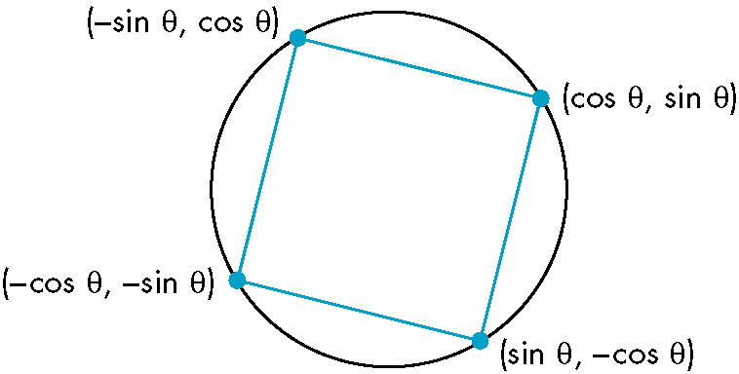
Animating Interactive Programs (1)
So far, the programs have been static.
Suppose that we want to create a picture in which one or more objects are changing or moving and thus their image must change.
The Rotating Square
We can display this square.
Suppose that we change the angle as
the program is running, thus
rotating the square about the
origin. (use glutPostRedisplay)

Slide 67
Animating Interactive Programs (2)
Now suppose that we want to increase the angle by a fixed amount whenever nothing else is happening. We can use the idle callback for this operation.
glutIdleFunc(idle);
void idle()
{
theta +=2;
if(theta >=360.0)
theta-=360.0;
glutPostRedisplay();
}

Slide 68
Animating Interactive Programs (3)
We want to be able to turn on and turn off the rotation feature.
glutMouseFunc(mouse);
void mouse(int button, int state, int x, int y)
{
if (button==GLUT_LEFT_BUTTON && state=GLUT_DOWN)
glutIdleFunc(idle);
if (button==GLUT_MIDDLE_BUTTON && state=GLUT_DOWN)
glutIdleFunc(NULL);
}

Slide 69
Animating Interactive Programs (4)
Double Buffering
When we redisplay the contents of the frame buffer, we want to do so at a rate sufficiently high that we cannot notice the clearing and redrawing of the screen. (60 or 85 times per second)
However, if we change the contents of the frame buffer during a refresh, we may see undesirable artifacts of how we generate the display. (complex object)
Double buffering provides a solution to these problems. Suppose that we have two color buffers at our disposal called the front and back buffers. The front buffer is always the one display, whereas the back buffer is the one into which we draw. We can swap the front and the back buffers at will from the application program.
glutSwapBuffers();

Slide 70
Animating Interactive Programs (5)
We set up double buffering by using the option GLUT_DOUBLE, instead of GLUT_SINGLE in glutInitDisplayMode.
If we put our rendering into the display callback, the effect will be to update the back buffer. When the rendering is done, we execute glutSwapBuffers and the results will be display, thus guaranteeing a smooth display.
Within the display callback, the first step is to clear the back buffer through glClear, and the final step is to invoke glutSwapBuffers.
glutInitDisplayMode(GLUT_RGB|GLUT_DOUBLE);
glutSwapBuffers();

Slide 71
Animating Interactive Programs (6)
Double buffering does not solve all the problems that we encounter with animate display. If the display is complex, we still may need multiple frames to draw the image into the frame buffer.
The front and back buffers are color buffers that hold information that can be display on the screen. Normally, when we use double buffering, we would like OpenGL to draw into the back buffer, but we can control which color buffer is used.
glutDrawBuffer(GL_BACK);
glutDrawBuffer(GL_FRONT_AND_BACK);

Slide 72
Animating Interactive Programs (7)
Using a Timer
If we take a simple program such as the rotating cube and execute it on a fast GPU, the cube will be rendered thousands of times per second, we will see a blur on the display. We might want to control the speed of the rotation.
There are least three approaches to the problem.
We could use various timing mechanisms provides by libraries or the operating system to put delays into the application program.
Another approach is provided by many commodity cards that allow users to set an option under which swapping of buffers is locked to the refresh rate.
GLUT provides the third option through the timer function:
glutTimerFunc(int display, void (*timer_func)(int), int value)
Execution of this function starts a timer in the event loop at delays the event loop for delay milliseconds.

Slide 73
Animating Interactive Programs (8)
GLUT allows only a single timer, using the recursive mechanism allows the program to execute the display callback at a fixed rate.
If we want it to execute at n frames per second, we can set the timer by registering the callback.
int n = 60;
glutTimerFunc(100, myTimer, n);
void myTimer(int v)
{
glutPostRedisplay();
glutTimerFunc(100/n, myTimer, v);
}

Slide 74
Design of Interactive Programs (1)
Defining what characterizes a good interactive program is difficult, but recognizing and appreciating a good interactive program is easy.
The simple model of rendering geometric objects into a color buffer is not sufficient to support many of operations, as slidebars, etc.
The second example is rubberbanding, a technique used for displaying line segment that change as they are manipulated interactively.

Slide 75
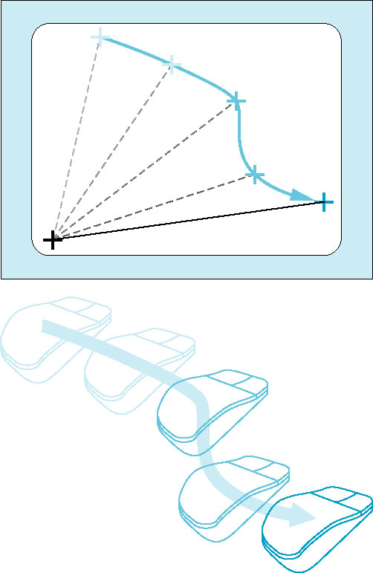
Design of Interactive Programs (2)
Note that before each new line segment appears, the previous line segment must be erased. Usually, the rubberbanding begins when a mouse button is pressed and continues until the button is released, at which time a final line segment is drawn.
We cannot implement this sequence of
operations using only what we have present
so far. One way to implement these operations
is to store the part of the display under the
menu and to copy it back when the menu is no
linger needed.

Slide 76
Logic Operations (1)
When a program specifies a primitive that is visible, OpenGL renders into a set of colored pixels that are written into the present drawing buffer.
If we start with a color buffer that has been cleared to black and draw a blue rectangle that is 10×10 pixels, then 100 blue pixels are copied into the color buffer, replacing 100 black pixels. In this mode, called copy, or replacement mode.

Slide 77
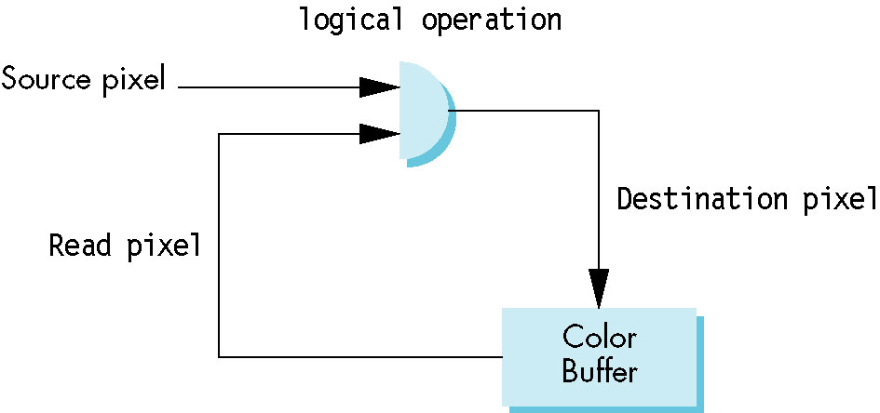
Logic Operations (2)
Consider the model shown in the figure, where we consider the writing of a single pixel into a color buffer. The pixel that we want to write is called the source pixel. The pixel in the drawing buffer that the source pixel will affect is called the destination pixel.
Here, we consider bitwise operations between the pixels. We are interested in two of these functions.

Slide 78
Logic Operations (3)
The first is replacement mode, in which each bit in the source pixel replaces the corresponding bit in the destination pixel.
The second mode is the exclusive OR or XOR mode in which corresponding bits in each pixel are combined using the exclusive or logical operation.
OpenGL supports all 16 logic modes. Copy mode is the default.
glEnable(GL_COLOR_LOGIC_OP);
glLogicOp(GL_XOR);

Slide 79
Logic Operations (4)
If s and d are corresponding bits in the source and destination pixels, we can denote the new destination bit as e, and it is given by
The most interesting property of the XOR operation is that if we apply it twice, we return to the original state.

Slide 80
Logic Operations (5)
Drawing Erasable Lines
Using the XOR drawing mode, we can draw erasable lines in a variety of ways.
Support that the OpenGL window is 500×500 pixel and the clipping window is a unit square with the origin at the lower-left corner, We use the mouse to get the first endpoint and store this point in object coordinates.
xm= x/500;
ym= (500-y)/500;
We then can get the second point and draw a line segement in XOR mode:

Slide 81
Logic Operations (6)
xmm=x/500;
ymm=(500-y)/500;
glLogicOp(GL_XOR);
glBegin(GL_LINES)
glVertex2f(xm, ym);
glVertex2f(xmm, ymm);
glLogicOp(GL_COPY);
glEnd();
glFlush();
If we enter another point with the mouse, we first draw the same line in XOR mode and then draw a second line using the first endpoint and the mouse input.

Slide 82
Logic Operations (7)
glLogicOp(GL_XOR);
glBegin(GL_LINES)
glVertex2f(xm, ym);
glVertex2f(xmm, ymm);
glEnd();
glFlush();
xmm=x/500;
ymm=(500-y)/500;
glLogicOp(GL_XOR);
glBegin(GL_LINES)
glVertex2f(xm, ym);
glVertex2f(xmm, ymm);
glLogicOp(GL_COPY);
glEnd();
glFlush();

Slide 83
Logic Operations (8)
We can sequence these operations by using the right mouse button to enter these data and the left mouse button to indicate that we accept the line segment.
We can keep track of vertices by adding a counter, as in the paint program to store which endpoint is expected next.
We can get a rubberband line by using the same operations in conjunction with a motion callback.

Slide 84
float xm, ym, xmm, ymm;
int first =0;
glutMouseFunc(mouse);
glutMotionFunc(move);
void mouse (int btn, int state, int x, int y)
{
if(btn==GLUT_LEFT_BUTTON && state=GLUT_DOWN)
{
xm=x/500;
ym=(500-y)/500;
glColor3d(0.0, 0.0, 0.0);
glLogicOp(GL_XOR);
first=0;
}

Slide 85
if(btn==GLUT_LEFT_BUTTON && state=GLUT_UP)
{
glRectf(xm, ym, xmm, ymm);
glFlush();
glColor3f(0.0, 1.0, 0.0);
glLogicOp(GL_COPY);
xmm=x/500.0;
ymm=(500-y)/500.0;
glLogicOp(GL_COPY);
glRectf(xm, ym, xmm, ymm);
glFlush();
}
}

Slide 86
Void move(int x, int y)
{
if (first ==1)
{
glRectf(xm, ym, xmm, ymm);
glFlush();
}
xmm=x/500.0;
ymm=(500-y)/500.0;
glRectf(xm, ym, xmm, ymm);
glFlush();
first =1;
}

